Slide 1
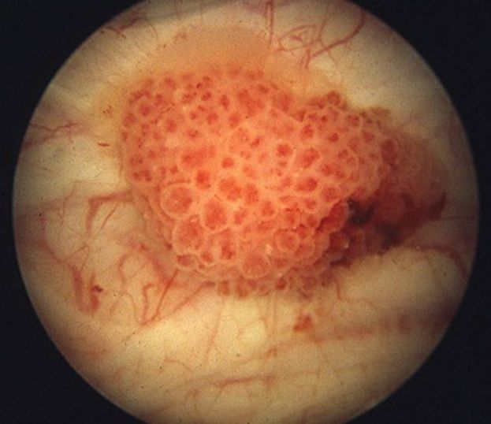
Notes:
Hey everyone! I’m Tristan Devictor from Dr. Gabor’s TJ computer systems lab. On this slide is a picture of a bladder tumor.

Slide 2
A Multimodal Machine Learning Model to Predict Bladder Cancer Death Hazards
Tristan Devictor
Dr. Gabor’s Computer Systems Lab, 2023-24
Notes:
My project was to create and train a multimodal machine learning model to predict bladder cancer death hazards. Let me get right into that.

Slide 3
Survival & Recurrence
730,044 cases in the U.S. in 2021
In situ tumors……… 97% survival rate
Local tumors……….. 72% survival rate
Regional tumors…. 40% survival rate
Distant tumors…….. 9% survival rate
Overall…………………. 78% survival rate
Overall…………………. 31-78% recurrence rate
Notes:
First off, bladder cancer is a deadly disease, and bladder cancer patients are extremely prone to recurrence.
When patients are diagnosed with an in situ tumor, meaning that the tumor is found and hasn’t spread from its original location, they generally have a 96% survival rate, meaning that 96% of patients survive five or more years after this initial diagnosis. We use a five-year benchmark to not be confused with other variables that might be responsible for death, most notably age since bladder cancer is more common in older folks: the average age of people diagnosed with bladder cancer is 73. Moving down this line of statistics, we see that patients initially diagnosed with a local tumor (which is slightly bigger and more widespread than an in situ tumor) have a 70% five-year survival rate. Patients with regional tumors, which means that the cancer has spread to nearby tissue and organs, have only a 39% survival rate. Finally, patients with distant tumors, which means that their cancer has spread far across their body, have only an 8% survival rate.
I was originally aiming to predict recurrence hazards—that is, the chance of bladder cancer reappearing in patients, since bladder cancer patients tend to have the highest recurrence rates of any cancer. As you can see, depending on risk factors, 31% to 78% of patients see their cancer recur within five years of their initial diagnosis or treatment. Investigations to predict the hazard of recurrence for specific patients are therefore crucial for medical prognoses and for determining the best courses of treatment.
However, I didn’t gain access to patients’ recurrence data in time (since this is medical data, so it is kept confidential and mandates a lot of permissions and clearances to gain access to), so I decided to focus on a survival analysis instead. I hoped that a similar machine learning model and workflow could be implemented to predict chances of recurrence.

Slide 4
How can we predict the hazard of death or recurrence a bladder cancer patient faces?
Notes:
That leads me to the guiding question of my research: How can we predict the hazard of death or recurrence a bladder cancer patient faces? Now to do that, I chose to take on a multimodal machine learning approach.

Slide 5
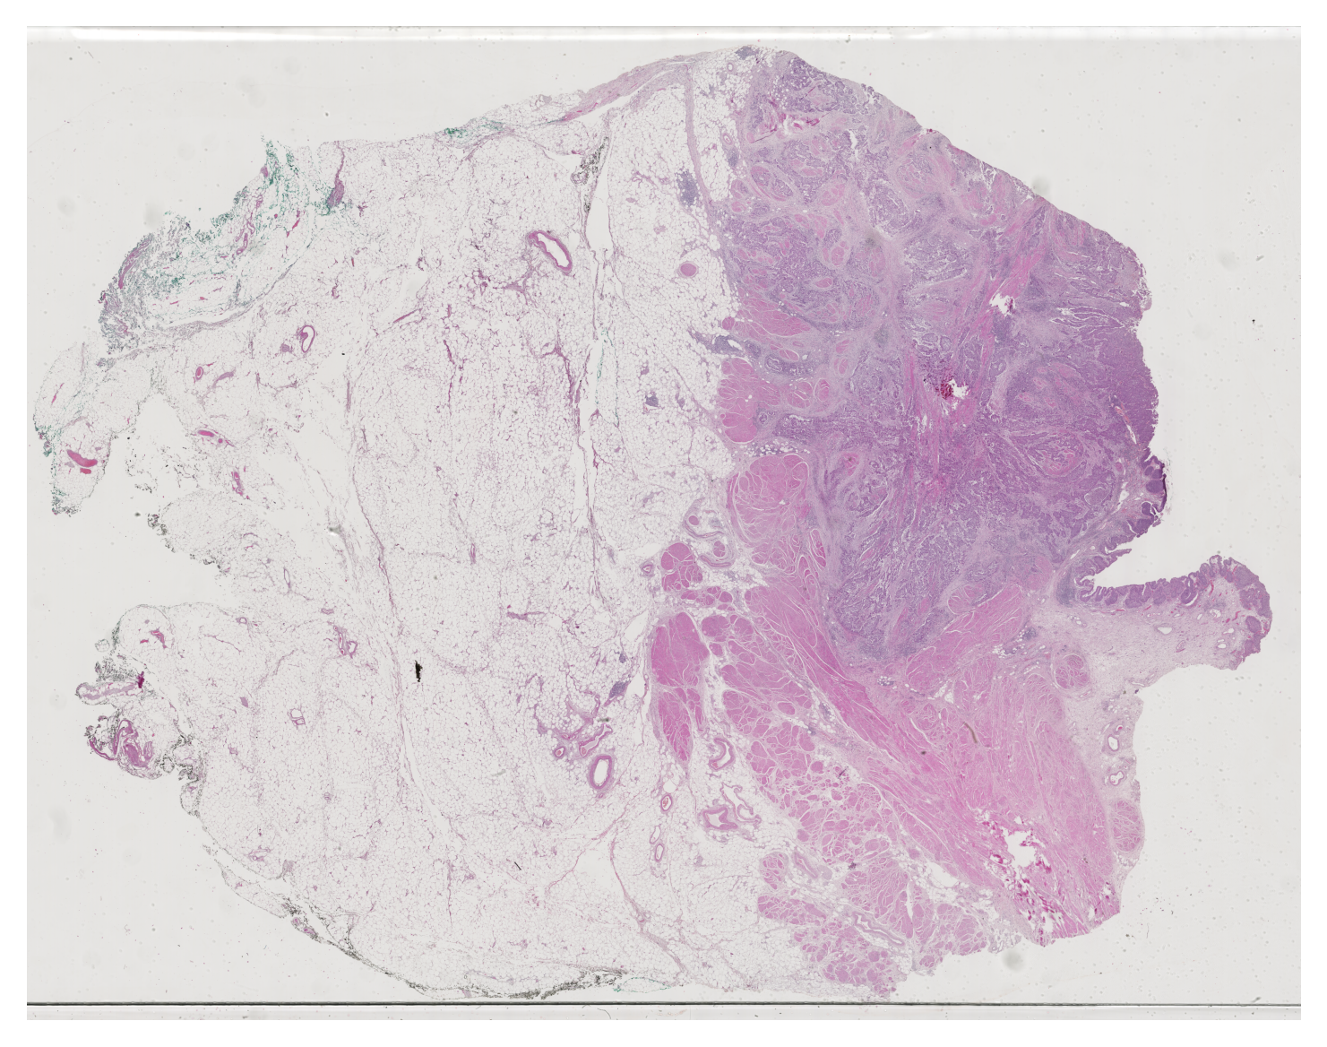
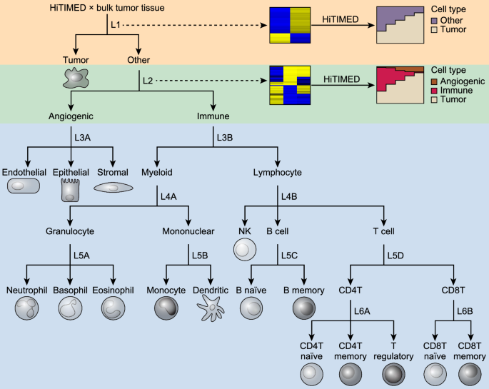
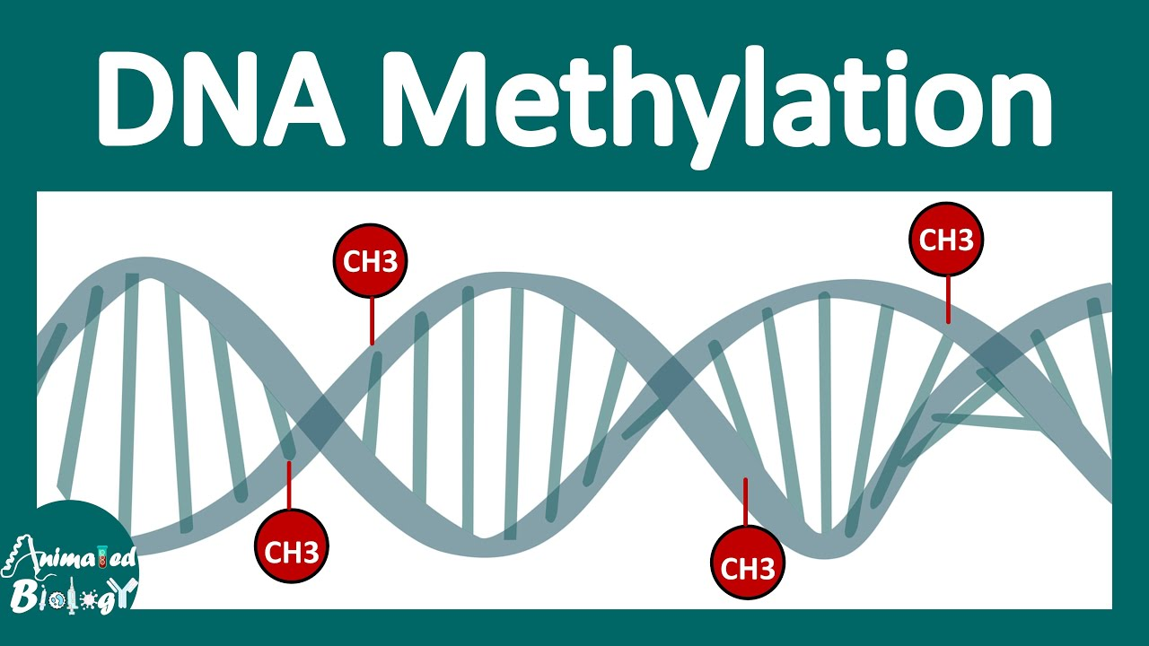
Whole slide images (WSIs)
DNA methylation (DNAm)
Tumor cell types (HiTIMED)
 | WSIs | DNAm | HiTIMED
Samples | 440 | 396 | 456
Sample size | 25,000 patches | 280,257 CpG sites | 17 cell types
Notes:
The first type of data I used was whole slide images, which I’ll refer to as WSIs. Experts take a biopsy of the patient’s bladder tumor and place it on a slide, then photograph the tissue. You can see an example of one of these images right up here on the slide. Each of these is an approximately 4-gigabyte picture of a sample of cancerous bladder tissue. Now to put that into perspective, the average picture on your phone takes up a couple megabytes, so each of these images is about 1000 times larger than a picture on your phone. That means that the big challenge in processing these images is to determine how to process such a huge amount of data.
The second type of data I used was information about DNA methylation, which I’ll be referring to as DNAm. DNA methylation is a normal process by which a methyl group attaches itself to a specific DNA site known as a CpG island. Irregularities in this process, such as methylation on DNA sites containing genes that regulate cell reproduction or not having enough methylation at normal sites, can provide information about cancer. The data therefore contained 280,257 numbers ranging from 0 to 1, 0 indicating no methylation and 1 indicating maximum methylation. Because there are so many CpG islands---that is, so much data to look at---it’s impossible to do by hand, which is why we need a computational approach.
The last data type I analyzed was tumor cell types, which is exactly what it sounds like—a percentage breakdown of the share of different types of cancer cells within the patient’s tumor. That’s abbreviated as HiTIMED for the algorithm used to obtain the data. Each patient’s tumor was divided into percentages of 17 different types of cells. For example, you could have 3% xxx cells, 5% yyy cells, and so on and so forth.
For summary, for each patient I was therefore looking at three different data types: I was looking at images of their tissue, information about their DNA methylation processes, and information about the proportions of different cell types in their tumor.
The quantity of data I was working with was massive. I had 400 4-gigabyte images, meaning that I had to rely on tremendous amounts of computational power to even train these models. Each picture was divided into about 25,000 patches. You can visualize that as a grid of 25,000 squares being overlaid onto each image; each square in the grid then becomes a patch.
I had a total of about 370 patients with all three data types available: these were the ones who were useful for the training of the multimodal model.
Now what does the multimodal model actually look like?

Slide 6
DNAm Cox-nnet
HiTIMED Cox-nnet
Multimodal Prognosis
WSI GCN
Notes:
This was the general structure of my multimodal model. There are three main sub-models, each trained on a different type of data—one for DNAm, one for HiTIMED, and one for the WSIs. I also planned to include a smaller model that would be trained on clinical data with classic risk factors like the patient’s age, how much they smoke, etc. The output of each of these unimodal models—that is the death hazard predicted by each modality—would serve as the input of the larger multimodal model. To be more precise, the multimodal model’s input was the output of the penultimate layer of each of the unimodal models rather than the final output, but the principle remains the same.

Slide 7
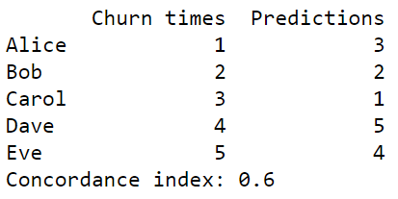
Concordance Index
Alice, Bob | 0
Alice, Carol | 0
Alice, Dave | 1
Alice, Eve | 1
Bob, Carol | 0
Bob, Dave | 1
Bob, Eve | 1
Carol, Dave | 1
Carol, Eve | 1
Dave, Eve | 0
C-Index | 6/10 = 0.6
Survival time Hazard
Alice
Bob
Carol
Dave
Eve
5
4
3
2
1
3
2
1
5
4
Concordance Index: 0.6
Notes:
But if the model predicts a quote-unquote death hazard, how is that meant to be interpreted? Is it a percentage chance of death? But what would that mean? How are we supposed to tell if the model is right or wrong? To answer those questions, we rely on the concordance index, or C-index. Let’s take a look at this example. Assume that the survival time is given in years, so Alice survives 5 years after her initial diagnosis, Bob survives 4, and so on and so forth. Meanwhile, our model assigns a death hazard of 3 to Alice, of 2 to Bob, and so on and so forth. To calculate the concordance index of this prediction, we compare every possible pair of patients. We can see that the model predicted that Alice would die before Bob since she was given a higher death hazard than him. The same is true for Alice and Carol. For Alice and Dave, the model performed better: it correctly predicted that Alice had a better chance of surviving than Dave by assigning her a lower death hazard than him. If we follow that process for every pair and find the model’s mean success, we obtain its C-index for this dataset. A C-index of 0.5 is what would be achieved by a random model; a C-index of 1 is what would be achieved by a perfect model. This was the metric I used to evaluate my work.

Slide 8
DNAm & HiTIMED
Implemented Cox-nnets for each data modality
Used Cox loss function (useful in time-to-event models)
Implemented variational autoencoder (VAE) for DNAm
Based on mean squared error after data reconstruction
Achieved C-index of 0.731 for DNAm
Achieved C-index of 0.639 for HiTIMED
Notes:
Let me get into a little more detail about my workflow for each of the unimodal models. The first two I created were the DNAm and HiTIMED models which were relatively similar. Both of them were relatively classic neural networks that I trained using the Cox loss function, which is a metric developed by previous researchers and is useful in what are known as time-to-event models—that is, models seeking to predict the time it will take for a specific event (here, death) to occur.
For the DNAm model, I tried creating a variational autoencoder, which is essentially a way of reducing the dimensionality—or the size—of the data. As you saw, each patient had about 280,000 data points, which is an enormous quantity of input for a machine learning model. The way the VAE trains is that it reduces the 280,000-dimensional input to an output layer of size 256. The new output is then used as the input of the unimodal DNAm Cox-nnet. To test whether the data is meaningfully or accurately compressed, we try to reconstruct it from the final output and compare the new and original values using a mean-squared error. However, my inclusion of a VAE didn’t improve or deteriorate the accuracy of the model, which achieved a C-index of 0.731. The HiTIMED model performed slightly less well, reaching a final C-index of 0.639.

Slide 9
WSIs
Downsampled images to workable sizes
Split images into patches
Generated feature vectors (embeddings) for each patch
Combined feature vectors into graph data structures
Trained graph convolutional network (GCN)
Achieved C-index of 0.588
Notes:
The most intensive task was to process the whole slide images and train the unimodal model on this data type. The first step was to downsample the images—which is essentially combining nearby pixels into their average color—in order to reduce the input size. Often, having too much input to a machine learning model makes it unable to train, or leads to exorbitant training times. The next step was to split each image into patches, or sections of 224 by 224 pixels. I then used a pre-trained embedding generator—that is, a model that turns each patch into a smaller vector of 1024 elements (called an embedding), which is similar in purpose to the variational autoencoder. I combined all of the embeddings into a graph data structure for each image. In these structures, the nodes represented an embedding and the edges represented neighbor connections. Therefore, each embedding that didn’t lie on the edge of the whole slide image had 8 neighbors (because each patch has 8 adjacent patches). I then trained a graph convolutional network, or GCN, which has been shown by previous studies to be an effective model for large image inputs because it takes into account the information stored by a patch embedding in relation to that stored by its neighbors. The GCN achieved a final C-index of 0.588, which was far less than the other unimodal models, but significant nevertheless.

Slide 10
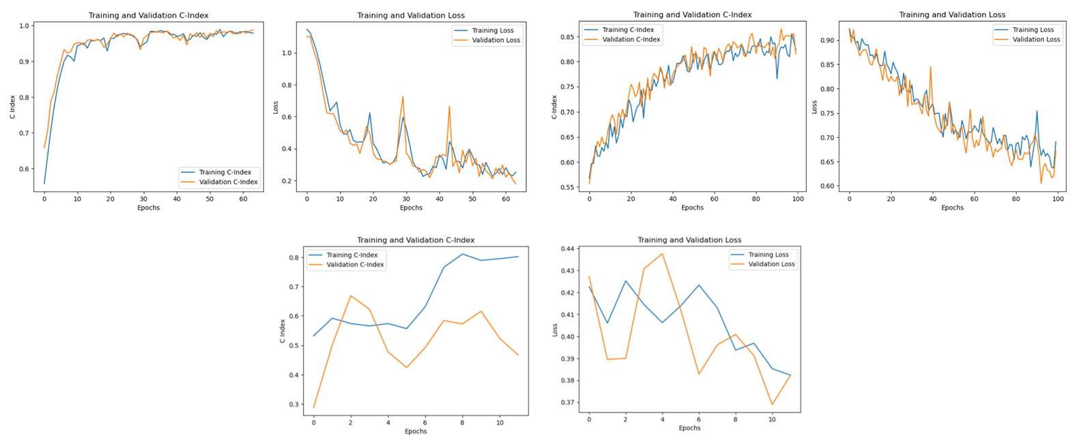
Unimodal Model Training
DNAm
HiTIMED
WSIs
Notes:
Next, I want to take a look at the training process of the different unimodal models. Both the DNAm and HiTIMED models trained very well: you can see that the C-index, whose progression is shown on the left in both of the sets of graphs, steadily increased and that the loss steadily decreased in both the training and validation sets. By contrast, the GCN struggled more with overfitting, which is showcased by the divergence of the training and validation C-indices, as well as by the divergence of the training and validation losses. However, I was still able to achieve positive results with an overall upward trend in C-index and downward trend in Cox loss.

Slide 11
Multimodal Model
Loaded pretrained unimodal models and froze weights
Linearly combined outputs of each unimodal model into inputs of multimodal model
Trained Cox loss model
Achieved C-index of 0.798
Notes:
The final step of my project was to implement the multimodal model. To do that, I loaded in the weights of each of my pretrained unimodal models (DNAm, HiTIMED, and WSIs), and froze them, meaning that I stopped them from being adjusted during the training of the multimodal model, since they had likely already achieved their optimal state. I then used a linear combination function created by a separate study to combine the outputs of each of the unimodal models into an optimal multimodal input. The model trained based on the Cox loss function, and reached a final C-index of 0.798.

Slide 12
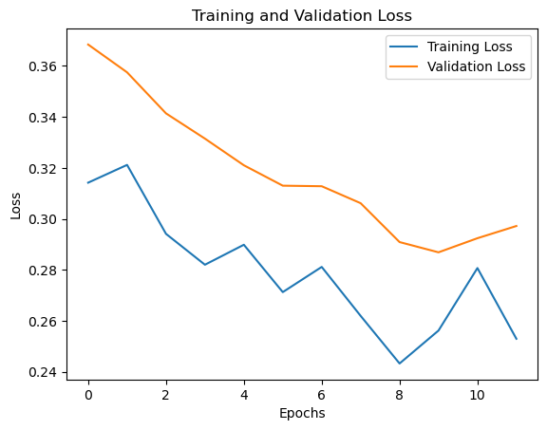
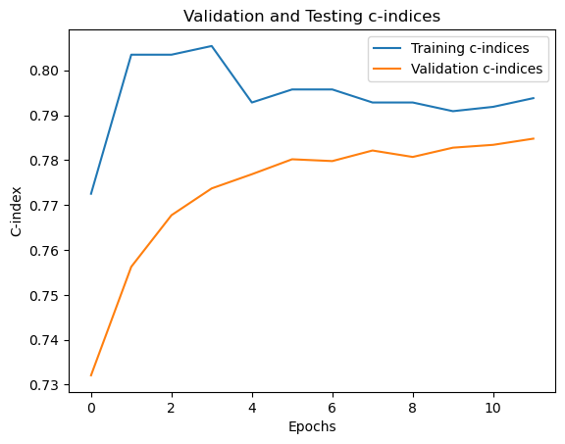
Multimodal Model Training
Notes:
The training progression of the multimodal model is shown in the two graphs here. Oddly enough, the validation C-index was consistently higher than the training C-index and the validation loss was consistently lower than the training loss. I retrained the model several times and observed this same phenomenon. However, the overall trend of decreasing loss and increasing C-index is clear.

Slide 13
Conclusion & Future Directions
Demonstrated ability to make bladder cancer survival predictions with these data modalities
Improve final C-index (reduce unimodal layers, add unimodal components, unfreeze unimodal weights, etc.)
Apply multimodal survival prediction workflow to recurrence prediction
Notes:
What are the conclusions of this project? I demonstrated that it’s possible to predict the hazard of death that bladder cancer patients face via a multimodal approach that draws on DNAm, HiTIMED, and whole slide image data. There are several approaches future studies could take to improve the final C-index. They could reduce the number of layers in each of the unimodal models in order to prevent over-specificity of the output; they could add additional unimodal components, like the clinical data I had already planned; they could also assume that the unimodal models were not in their optimal states and allow those weights to be adjusted during the multimodal training. However, that last adjustment would require far more memory than I had access to even with supercomputers. A final future step would be to apply this multimodal workflow to recurrence, rather than survival prediction.
And with that, thank you so much for listening!

